Slide 1
Teacher: Vũ Thị Huyền

Slide 2
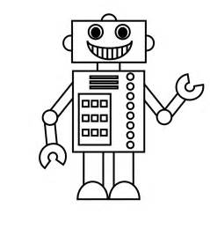
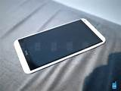
SMART PHONE
ROBOTS
COMPUTER

Slide 3
UNIT 11:
SCIENCE AND TECHNOLOGY
LESSON 5: SKILLS 1

Slide 4
* Activity 1: Match the headings with the passages
1. Can we live longer?
2. Can we live there?
3. Future home prediction?

Slide 5
* Activity 2: Matching
1. a reality | a. examine carefully to find out more about something.
2. explore | b. used instead of something else
3. possibility | c. equipment that helps save energy
4. replaced | d. a thing that actually exists or happens
5. anti-ageing pills | e. something that is likely to happen
6. energy saving devices | f. medicine that can prevent ageing
A
B

Slide 6
* Activity 3: Answer the questions
1.Why are scientists planning to send people to Mars?
- Because they want to explore the possibility of living there.
2. How will anti-ageing pills help people?
- They help people live longer.
3. How long does an average person live now?
- 70 ( for men ) or 75 ( for women).
4. What are some energy saving devices?
- They are solar panels and solar windows.
5. What will home robots do in the future?
- In the future, robots do chores such as cleaning, cooking, washing and organising everything.

Slide 7
* Activity 4: fill in the table
Advances | Advantages | Disadvantages
Robots
Nuclear energy
Nutrition pills
Smart phones
Space travel
do a lot of things
unemployment
convenient, clean…
expensive, unsafe
help people live longer
expensive
convenient, entertaining
environmentally unfriendly
exciting
expensive, dangerous

Slide 8
Look out
Look out!
We use ‘ at the same time ’ to introduce a contrasting fact.
- Sử dụng ‘ at the same time’ để mở đầu cho một sự việc tương phản với sự việc ban đầu.

Slide 9
* Activity 5
A: I think + advances + will help us….
B: Yes. But at the same time, …
C: And they’ll…
Example:
A: I thinks robots will help us do many boring or difficult jobs.
B: Yes. But at the same time, they may bring a lot of unemployment.
C: And they’ll make us lazy and inactive.

Slide 10
Home work
- Complete the lesson at home.
- Prepare the new lesson
Unit 11: Science and technology
Lesson 6: Skills 2

